Slide 1
JAVA NAMING CONVENTION PACKAGES & IMPORT

Slide 2
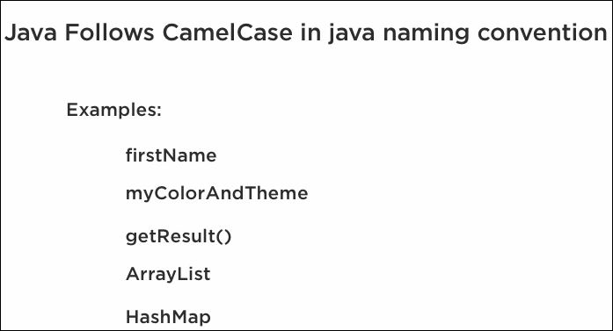
Java Naming Convention

Slide 3
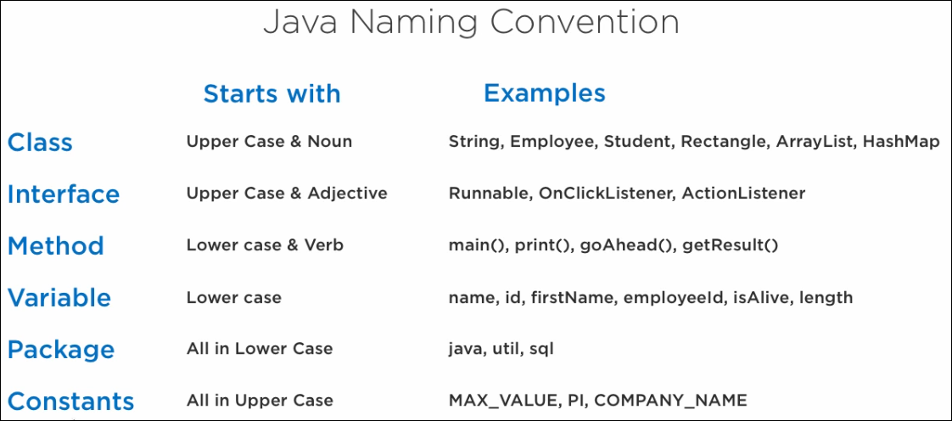

Slide 4
WHAT IS PACKAGE IN JAVA?
Grouping similar type of classes, interfaces, and sub-classes collectively based on functionality.
ADVANTAGES
Re-usability: The classes contained in the packages of another program can be easily reused
Name Conflicts: Packages help us to uniquely identify a class,
Eg: company.sales.Employee
and
company.marketing.Employee

Slide 5
Controlled Access: Access protection such as protected classes, default classes and private class
Data Encapsulation: A way to hide classes, preventing other programs from accessing classes that are meant for internal use only
Maintanance: We can organize your project better and easily locate related classes

Slide 6
TYPES OF PACKAGES IN JAVA
Based on whether the package is defined by the user or not
Built-in Packages
User Defined Packages

Slide 7
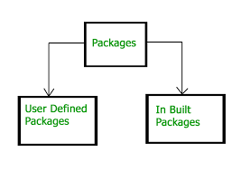
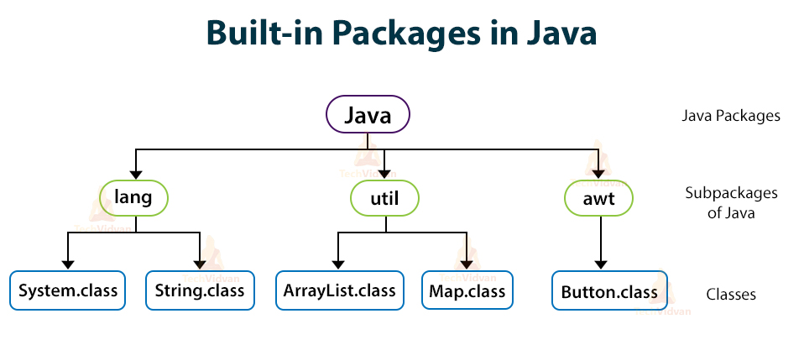

Slide 8
How to access package from another package?
import package.*;
import package.classname;
fully qualified name.
Using packagename.*
All the classes and interfaces of this package will be accessible but not sub packages.
Using packagename.classname
Only declared class of this package will be accessible

Slide 9
USING FULLY QUALIFIED NAME
Only declared class of this package will be accessible.
There is no need to import.
Need to use fully qualified name every time when you are accessing the class or interface.
It is generally used when two packages have same class name
e.g. java.util
and
java.sql packages contain Date class.

Slide 10
ADVANTAGES :
Used to categorize the classes and interfaces so that they can be easily maintained.
It provides access protection.
It removes naming collision

Slide 11
STATIC IMPORT
Access any static member of a class directly. No need to qualify it by the class name.
ADVANTAGES
Less coding is required if you have access any static member of a class oftenly.
DISADVANTAGES
Overuse the static import makes program unreadable and unmaintainable.

Slide 12
EXAMPLES

